Slide 1

Symmetric Key Cryptography
30.<number>
Copyright © The McGraw-Hill Companies, Inc. Permission required for reproduction or display.

Slide 2
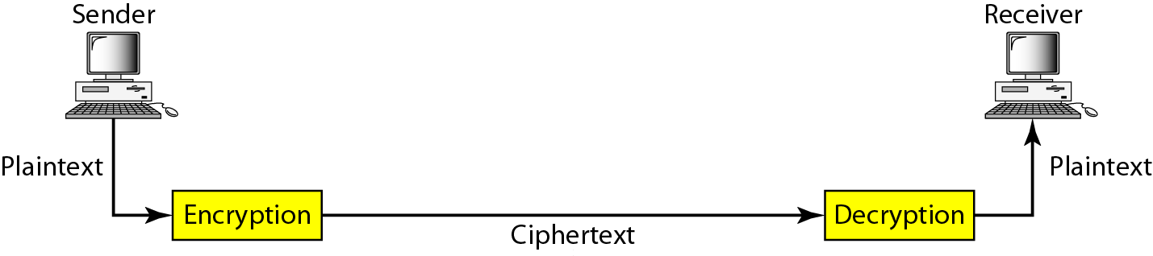
Figure 30.1 Cryptography components
30.<number>

Slide 3
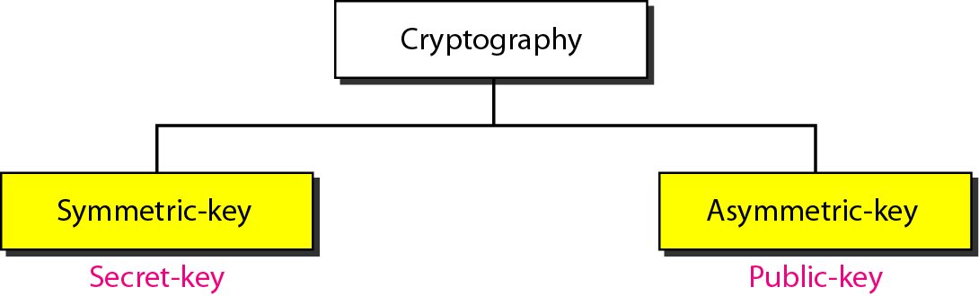
Figure 30.2 Categories of cryptography
30.<number>

Slide 4
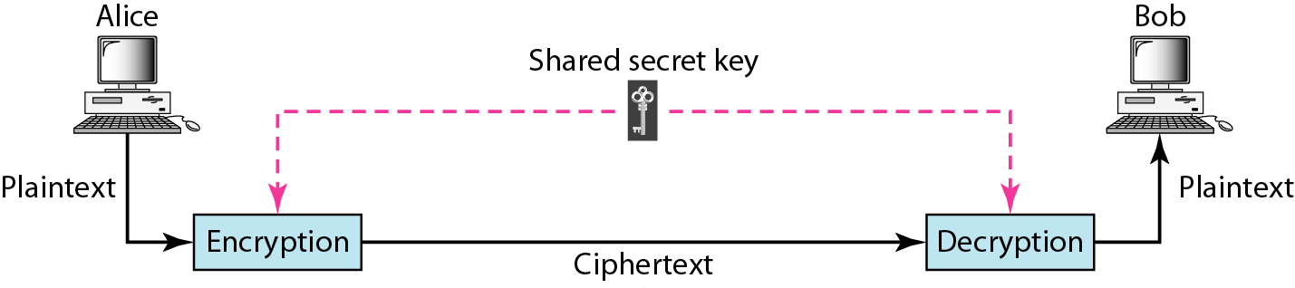
Figure 30.3 Symmetric-key cryptography
30.<number>

Slide 5

Note
In symmetric-key cryptography, the same key is used by the sender
(for encryption)
and the receiver (for decryption).
The key is shared.
30.<number>

Slide 6
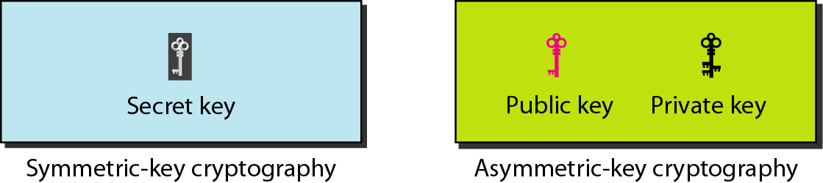
Figure 30.5 Keys used in cryptography
30.<number>

Slide 7
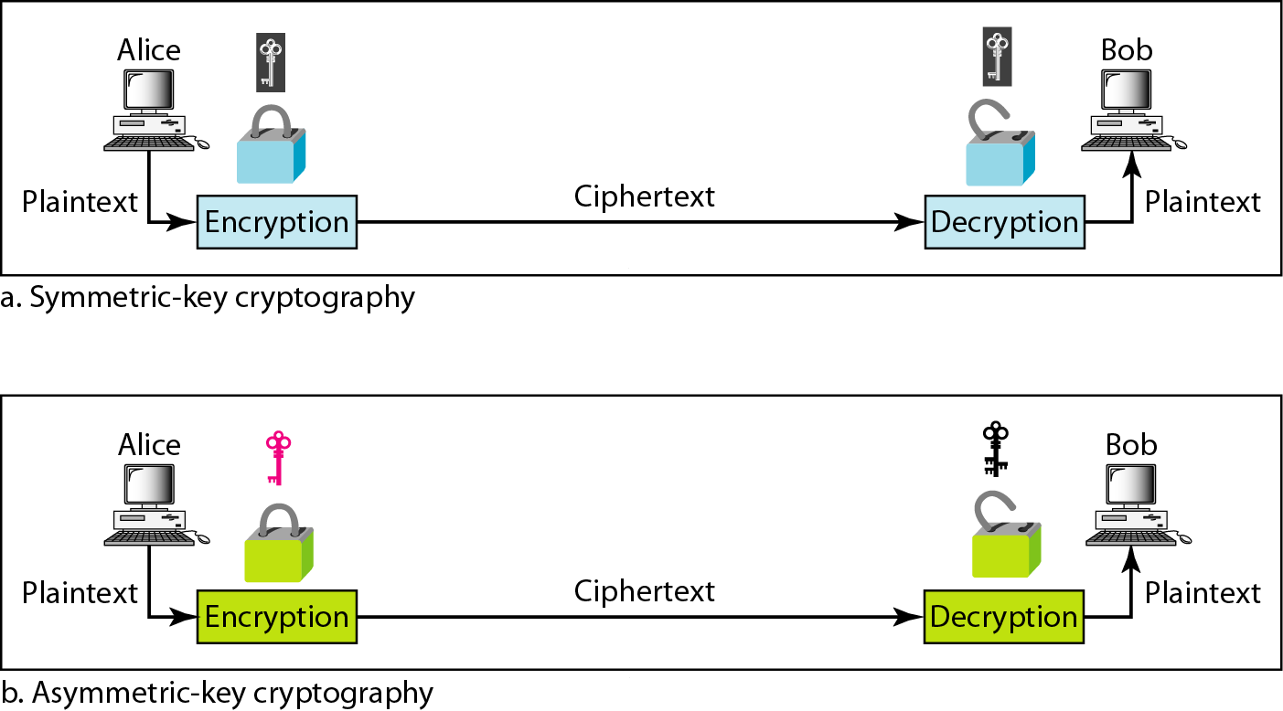
Figure 30.6 Comparison between two categories of cryptography
30.<number>

Slide 8
30-2 SYMMETRIC-KEY CRYPTOGRAPHY
Symmetric-key cryptography started thousands of years ago when people needed to exchange secrets (for example, in a war). We still mainly use symmetric-key cryptography in our network security.
Topics discussed in this section:
Traditional Ciphers
Simple Modern Ciphers
Modern Round Ciphers
Mode of Operation
30.<number>

Slide 9
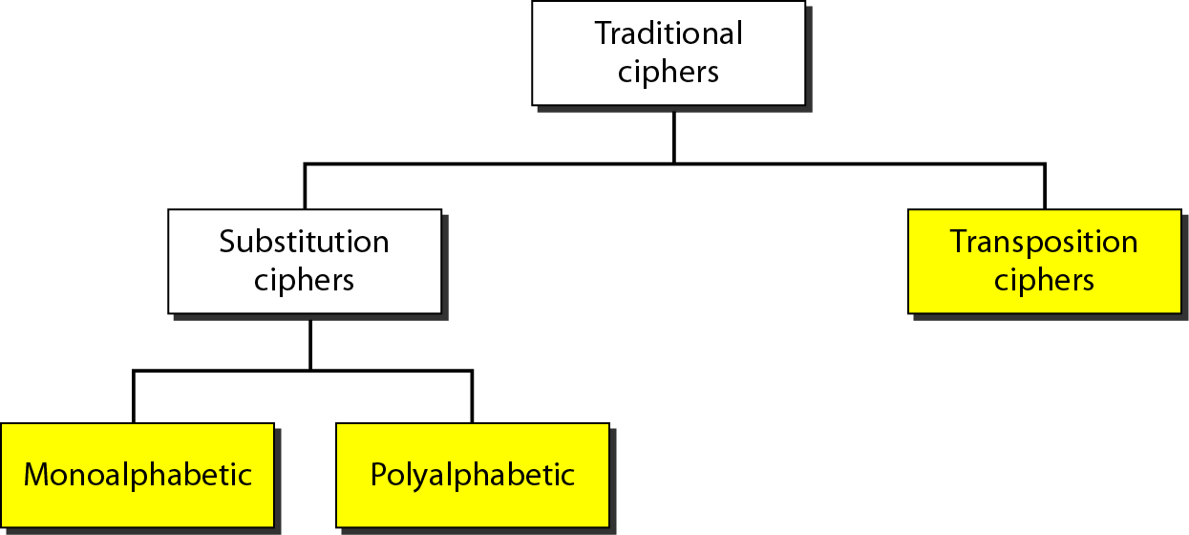
Figure 30.7 Traditional ciphers
30.<number>

Slide 10
Note
A substitution cipher replaces one symbol with another.
30.<number>

Slide 11
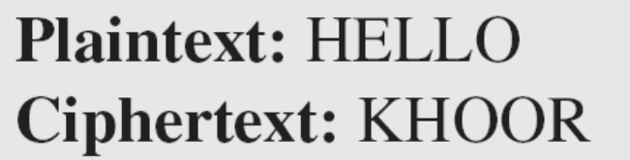
Example 30.1
The following shows a plaintext and its corresponding ciphertext. Is the cipher monoalphabetic?
Solution
The cipher is probably monoalphabetic because both occurrences of L’s are encrypted as O’s.
30.<number>

Slide 12
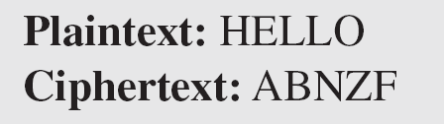
Example 30.2
The following shows a plaintext and its corresponding ciphertext. Is the cipher monoalphabetic?
Solution
The cipher is not monoalphabetic because each occurrence of L is encrypted by a different character. The first L is encrypted as N; the second as Z.
30.<number>

Slide 13
Note
The shift cipher is sometimes referred to as the Caesar cipher.
30.<number>

Slide 14
Example 30.3
Use the shift cipher with key = 15 to encrypt the message “HELLO.”
Solution
We encrypt one character at a time. Each character is shifted 15 characters down. Letter H is encrypted to W. Letter E is encrypted to T. The first L is encrypted to A. The second L is also encrypted to A. And O is encrypted to D. The cipher text is WTAAD.
30.<number>

Slide 15
Example 30.4
Use the shift cipher with key = 15 to decrypt the message “WTAAD.”
Solution
We decrypt one character at a time. Each character is shifted 15 characters up. Letter W is decrypted to H. Letter T is decrypted to E. The first A is decrypted to L. The second A is decrypted to L. And, finally, D is decrypted to O. The plaintext is HELLO.
30.<number>

Slide 16
Note
A transposition cipher reorders (permutes) symbols in a block of symbols.
30.<number>

Slide 17
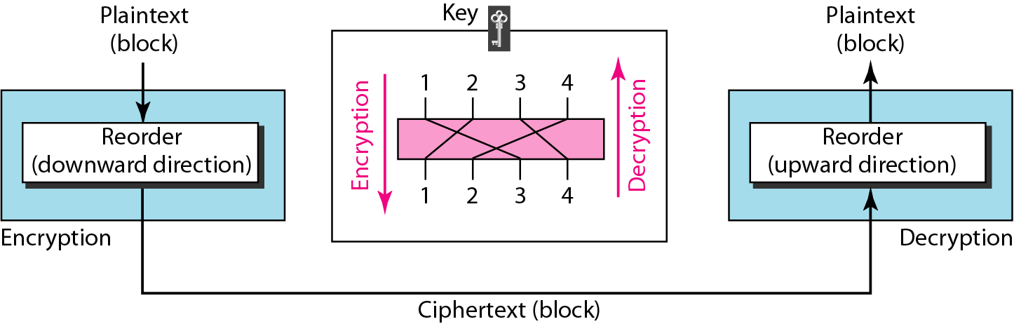
Figure 30.8 Transposition cipher
30.<number>

Slide 18
Example 30.5
Encrypt the message “HELLO MY DEAR,” using the key shown in Figure 30.8.
Solution
We first remove the spaces in the message. We then divide the text into blocks of four characters. We add a bogus character Z at the end of the third block. The result is HELL OMYD EARZ. We create a three-block ciphertext ELHLMDOYAZER.
30.<number>

Slide 19
Example 30.6
Using Example 30.5, decrypt the message “ELHLMDOYAZER”.
Solution
The result is HELL OMYD EARZ. After removing the bogus character and combining the characters, we get the original message “HELLO MY DEAR.”
30.<number>

Slide 20
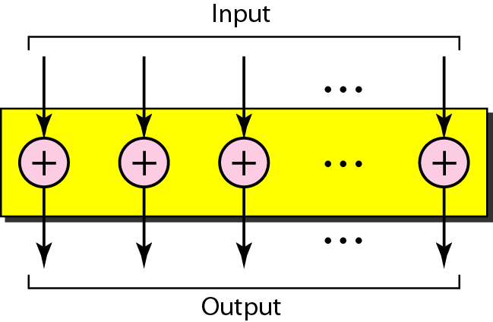
Figure 30.9 XOR cipher
30.<number>

Slide 21
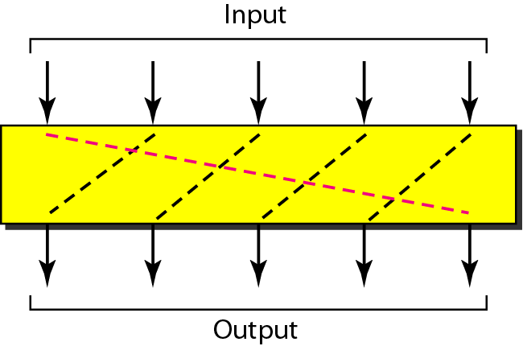
Figure 30.10 Rotation cipher
30.<number>

Slide 22
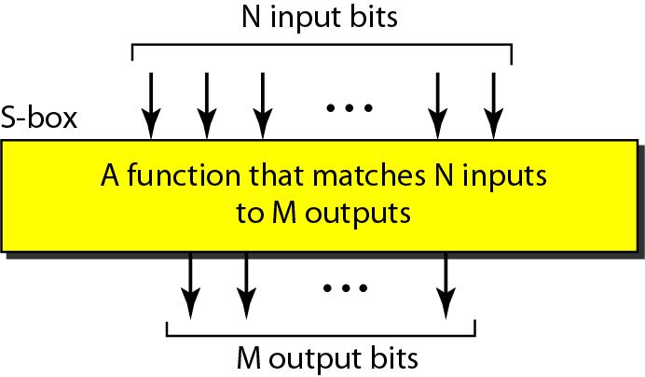
Figure 30.11 S-box
30.<number>

Slide 23
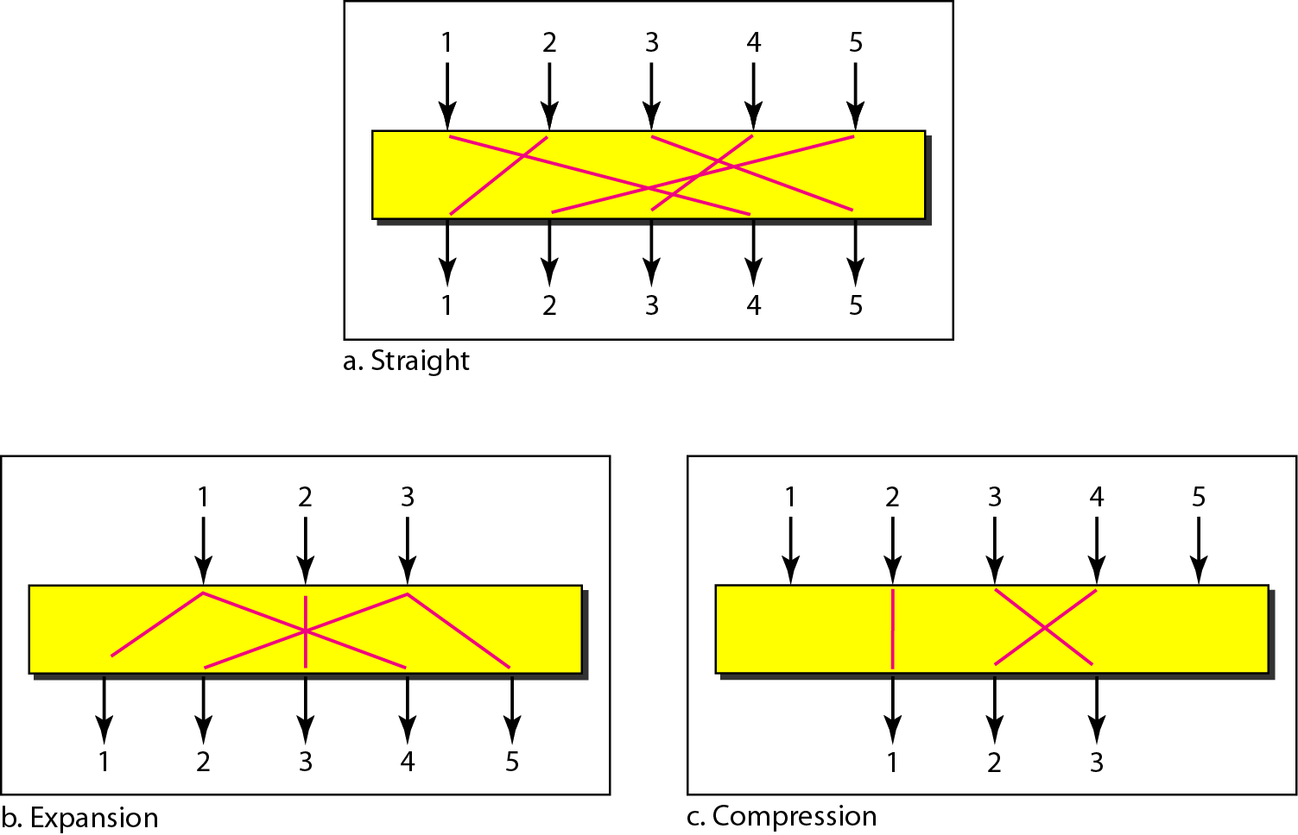
Figure 30.12 P-boxes: straight, expansion, and compression
30.<number>

Slide 24
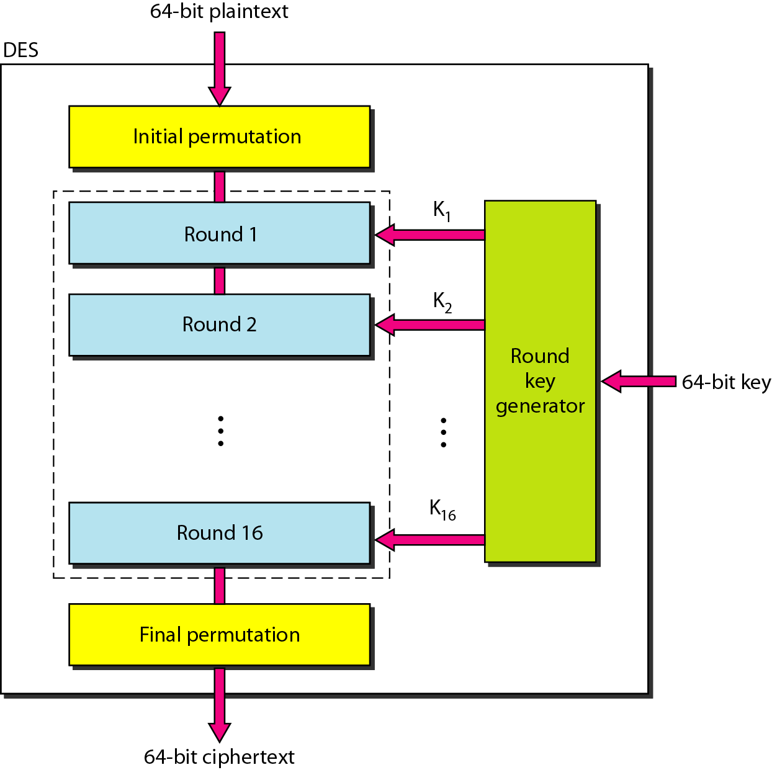
Figure 30.13 DES
30.<number>

Slide 25
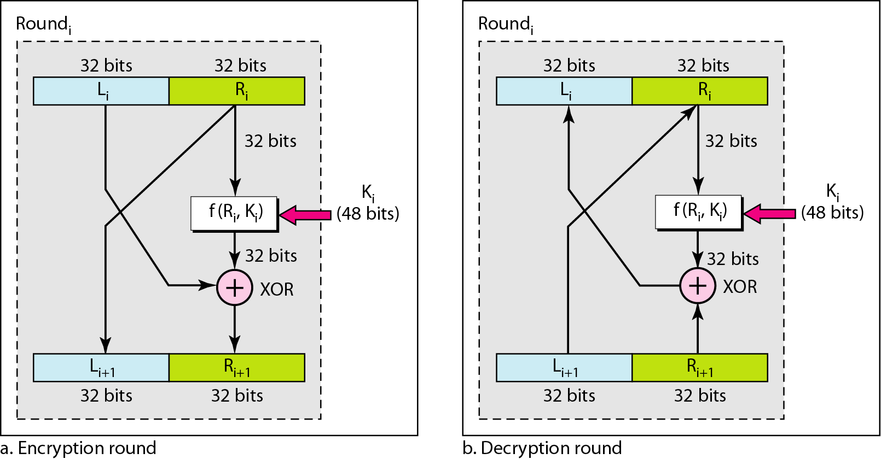
Figure 30.14 One round in DES ciphers
30.<number>

Slide 26
Figure 30.15 DES function
30.<number>

Slide 27
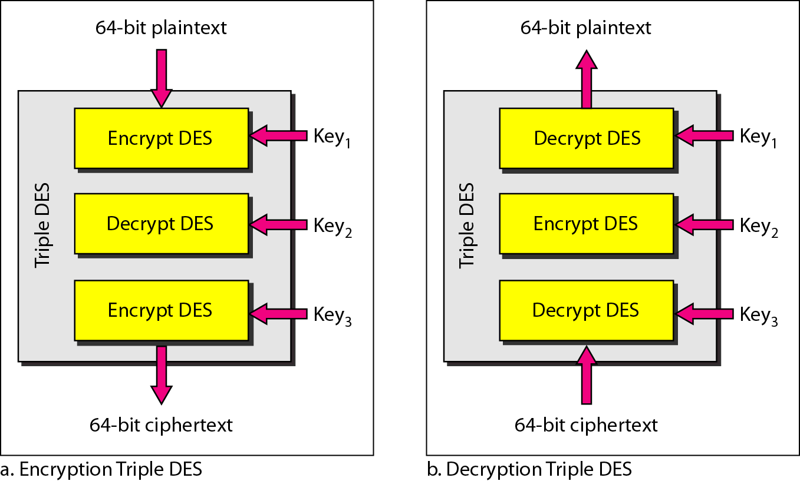
Figure 30.16 Triple DES
30.<number>

Slide 28
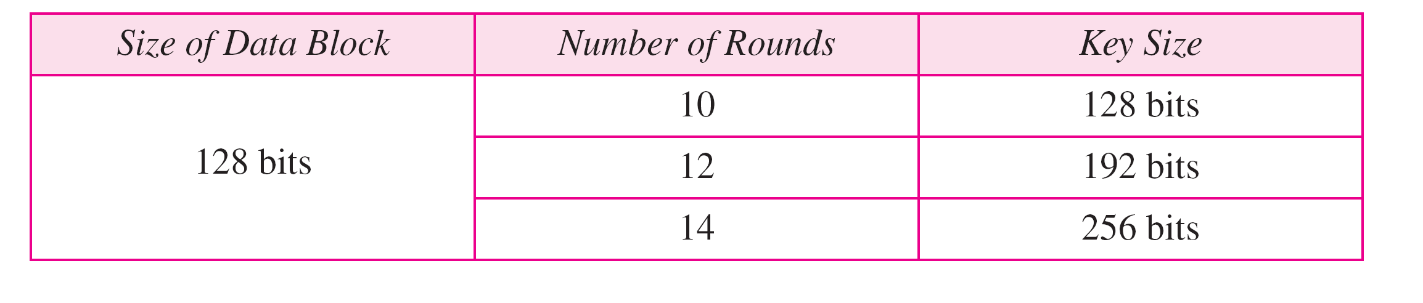
Table 30.1 AES configuration
30.<number>

Slide 29
Note
AES has three different configurations with respect to the number of rounds and key size.
30.<number>

Slide 30
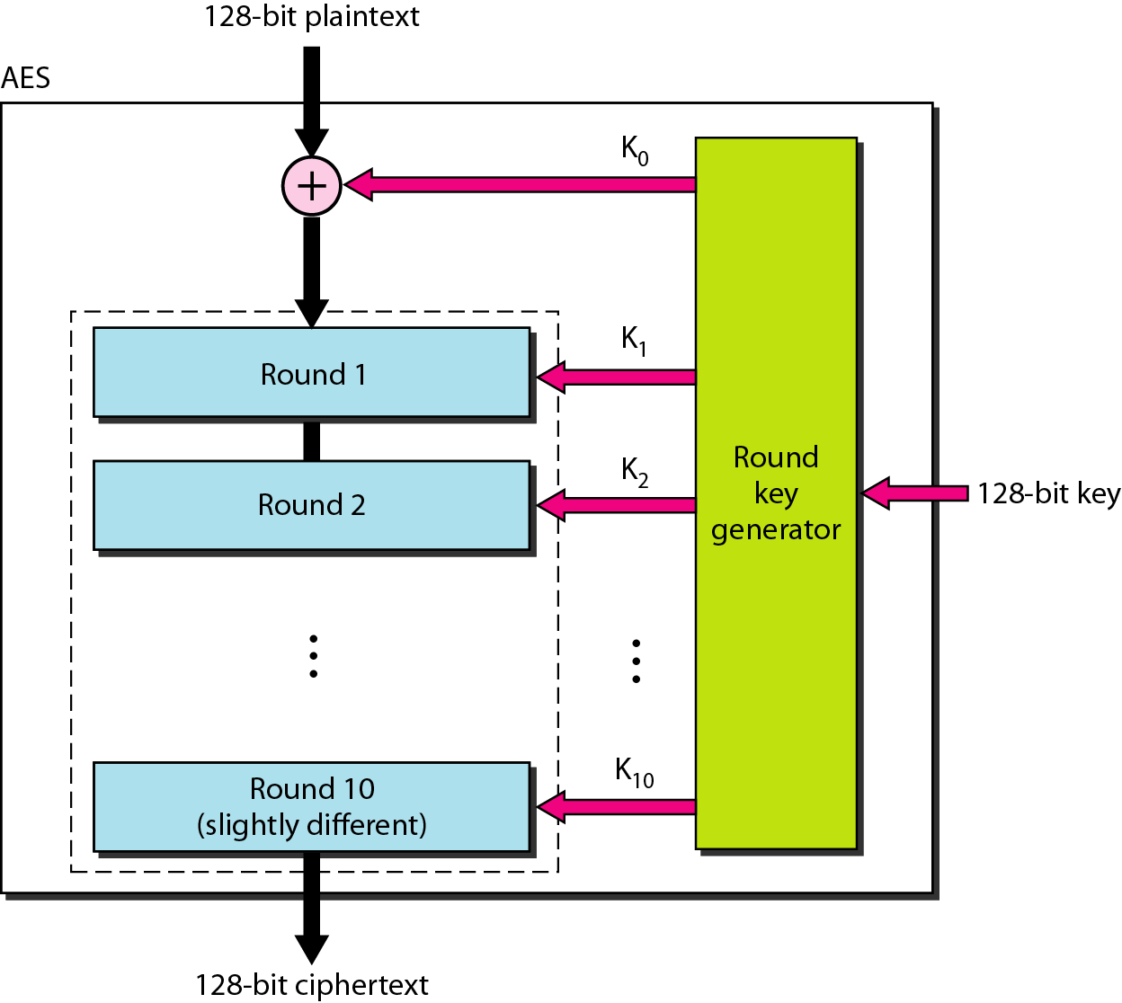
Figure 30.17 AES
30.<number>

Slide 31
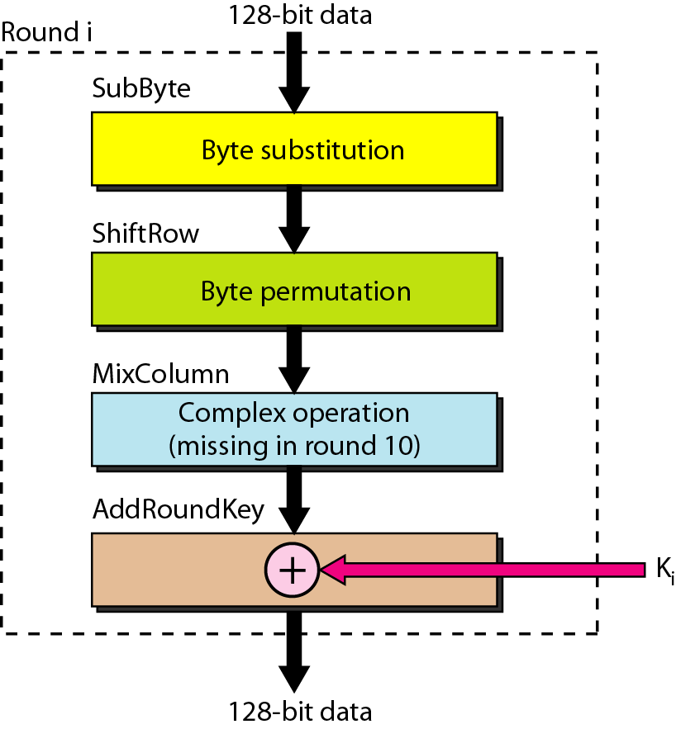
Figure 30.18 Structure of each round
30.<number>

Slide 32
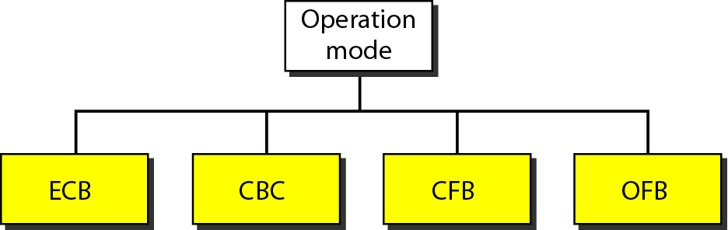
Figure 30.19 Modes of operation for block ciphers
30.<number>

Slide 33
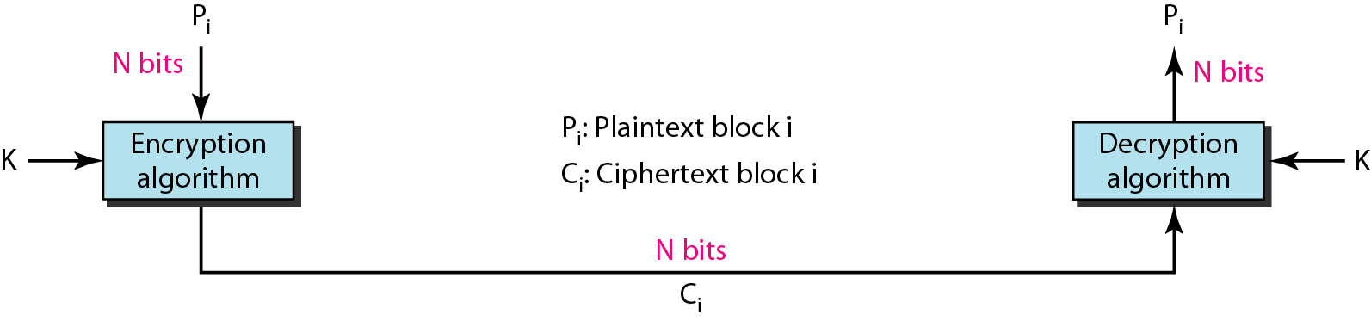
Figure 30.20 ECB mode
30.<number>

Slide 34
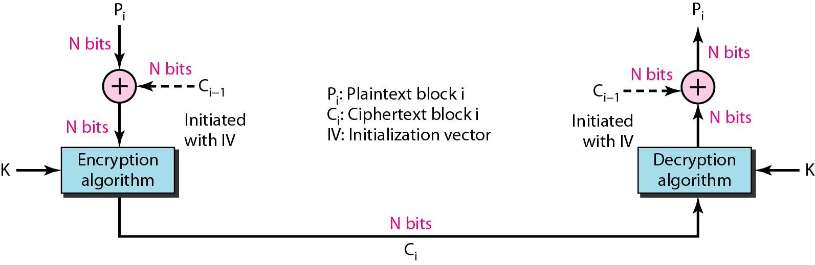
Figure 30.21 CBC mode
30.<number>

Slide 35
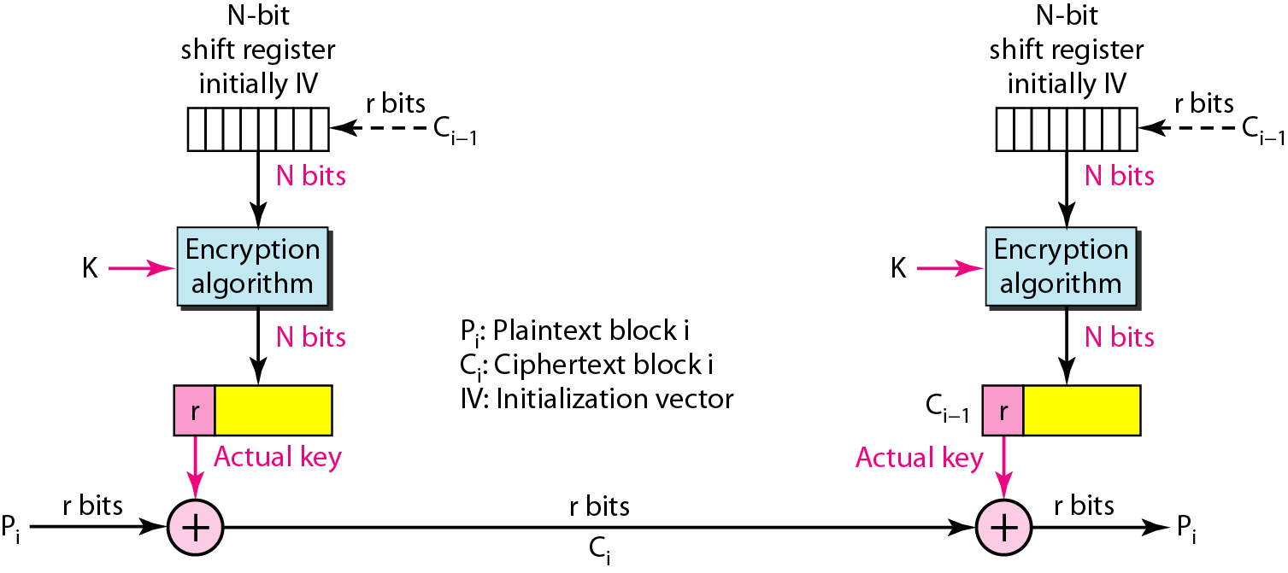
Figure 30.22 CFB mode
30.<number>

Slide 36
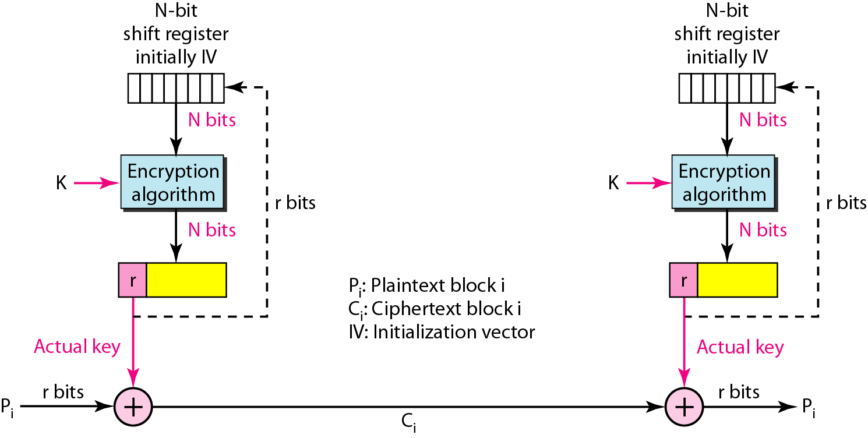
Figure 30.23 OFB mode
30.<number>

